Slide 1
Building Interactive ML Web Apps using Dash
Transform machine learning models into interactive, user-friendly web applications using Dash — no frontend expertise required.

Slide 2
Contents
01
01
Why Do We Need ML Web Apps?
What User Does in App
02
02
What is Dash?
Advantages of Dash for ML Demos
03
03
What is FastAPI?
Dash + FastAPI in Real Systems
04
04
Basic Components of Dash
Key Workflow Components

Slide 3

Why Do We Need ML Web Apps?
Machine learning models deliver value only when the right people can use them. Web apps close the gap between technical teams and business users.
The Challenge
The Solution
The Bridge
ML models are typically built and run inside Python notebooks — an environment that business users cannot access or operate effectively without technical training.
Simple web interfaces let users upload data, view real-time predictions, and make informed decisions — without writing a single line of code.
Web apps create a shared language between data science teams and business stakeholders, making ML outputs accessible, actionable, and trustworthy.

Slide 4

What is Dash?
Dash is a Python framework for building web applications, designed specifically for data scientists who want to create interactive dashboards without any frontend expertise. It abstracts away HTML, CSS, and JavaScript entirely.
Flask
Plotly
React
Provides the backend server that handles HTTP requests and responses under the hood.
Powers interactive charts, graphs, and data visualizations rendered in the browser.
Handles the frontend UI components and dynamic page rendering seamlessly.
Key Advantage: The entire application is written in pure Python — no HTML, CSS, or JavaScript knowledge required.

Slide 5
What Can We Build Using Dash?
Dash is a versatile framework suited for a wide range of interactive, data-driven applications across industries.
ML Prediction Dashboards
Business Analytics Dashboards
Serve model predictions through interactive UI for end users.
Summarize KPIs and business metrics with real-time charts.
Monitoring Systems
Financial & Stock Analytics
Track model performance and data drift over time.
Visualize market data and run scenario analysis interactively.
Data Exploration Tools
Model Performance Dashboards
Let analysts filter, slice, and explore datasets visually.
Compare model metrics, confusion matrices, and evaluation curves.

Slide 6
When Should We Use Dash?
✓ Use Dash When
✗ Not Ideal When
Visual Dashboards
API Only Needed
You want interactive visual dashboards with graphs, charts, and filterable tables.
Your use case only requires backend API endpoints with no visual layer.
User Interaction
No Frontend Required
Users need to interact using sliders, dropdowns, file uploads, or form inputs.
There is no user interface or visualization component in your system design.
Python-Only Development
Data scientists want to build a full UI without learning any frontend skills.

Slide 7
What is FastAPI?
FastAPI is a modern, high-performance backend web framework for building APIs and microservices in Python. It is built on standard Python type hints and is designed for production-grade deployments.
Purpose
Performance
Build RESTful APIs and scalable microservices for ML models and data pipelines.
Extremely fast and production-ready, rivaling Node.js and Go in throughput benchmarks.
Output
Capabilities
Returns structured JSON responses, making it ideal for programmatic consumption.
Supports fully async operations, automatic documentation, and data validation via Pydantic.

Slide 8
Dash vs FastAPI
Understanding the key differences helps you choose the right tool — or the right combination — for your ML project.
Feature
Dash
FastAPI
Purpose
Web UI + Backend
Backend API only
Output
Web pages, charts
JSON responses
UI Components
Yes
No
Best For
Dashboards
Services
ML Use Case
Demo + visualization
Production pipelines

Slide 9





How Dash Works
Dash creates a seamless connection between user interactions and Python-based machine learning models through a real-time callback system. Everything runs server-side in Python.
User
UI
Callback
Interacts with UI elements
Captures and sends actions to server
Python function fires automatically
ML Model
Output
Processes the input data
Updates graphs and tables in real time
The browser sends user actions to the Dash server, which runs Python callbacks and pushes updated components — graphs, tables, and counts — back to the UI instantly.

Slide 10

Basic Components of Dash
Every Dash application is built from three core building blocks. Understanding them is the foundation of building any ML-powered dashboard.
1
2
3
Layout
Components
Callbacks
Defines the page structure and visual organization of all elements on the dashboard. Written entirely in Python using Dash HTML and Core Components.
Interactive UI elements including dropdowns, sliders, buttons, file upload widgets, data tables, and Plotly graphs — all declared in Python.
Python functions decorated with @app.callback that connect inputs to outputs. They fire automatically whenever a user triggers an event.

Slide 11
Our Demo Project – Problem Statement
The demo application solves a real-world credit risk problem: predicting the probability that a customer will default on a loan, enabling data-driven lending decisions.
Model Inputs
Model Outputs
Age
Employment status
Address duration (years at current address)
Debt-to-income ratio
Credit card debt
Other outstanding debt
Probability of default — a continuous score between 0 and 1
Classification label — defaulter or non-defaulter based on a user-defined threshold
The threshold can be adjusted interactively in the app, allowing business users to tune the model's sensitivity to their risk appetite.

Slide 12


ML Model Used
The demo uses a straightforward but powerful binary classification approach that is well-suited for credit risk scoring and highly interpretable for business stakeholders.
1
2
Binary Logistic Regression
Probability Prediction
Implemented using sklearn. A well-understood model that outputs probabilities natively, making it ideal for threshold-based classification.
Uses predict_proba() to return the probability of default for each customer record in the uploaded test dataset.
3
4
Classification Output
Training Strategy
Class 0 → Non-Defaulter | Class 1 → Defaulter. The classification is applied by comparing the probability to the selected threshold.
The model is trained once when the server starts up. It is not retrained on each request, ensuring consistent, fast predictions for all users.

Slide 13

How Training is Handled
The training approach is designed to simulate production systems while maintaining efficiency for demonstration purposes. Training happens once, at startup.
Training Dataset
Model Training
Shared Model Instance
The labeled dataset is stored on the server and automatically loaded when the application starts. No external database connection is required.
The model is fitted once during startup. This avoids redundant computation on every prediction request, mirroring how production ML services operate.
The same trained model object is used to serve predictions for all users simultaneously, ensuring consistent results across sessions.
Faster Predictions
No Retraining
Production-Like
No training overhead per request.
Model state is stable across all user interactions.
Reflects real enterprise ML deployment architecture.

Slide 14
What the User Does in the App
The application provides a simple, code-free interface for business users to interact with the ML model. No Python knowledge or technical background is needed.
View Results
Select Probability Threshold
The dashboard instantly displays the number of predicted defaulters, a probability distribution chart, and a sample prediction table — all updated in real time.
Upload Test CSV File
User adjusts the decision threshold using a dropdown to control sensitivity — higher thresholds flag fewer customers as defaulters.
User drags and drops or selects a CSV file containing customer records to be scored by the model.
No coding required — everything is handled through the intuitive web interface, making this accessible to any business stakeholder.

Slide 15

Dash Callback Logic in the Project
Callbacks are the engine of the application. They automate the entire prediction workflow, responding to user actions in real-time without any manual intervention.
Callback Triggers
Inside the Callback
A new CSV file is uploaded by the user
Read and parse the uploaded CSV file
Run predict_proba() on all records
Apply the selected threshold to classify each record
Update the distribution chart and prediction counts
The probability threshold value is changed
Everything automated — no manual intervention required once the callback fires. The user sees updated results within milliseconds.

Slide 16
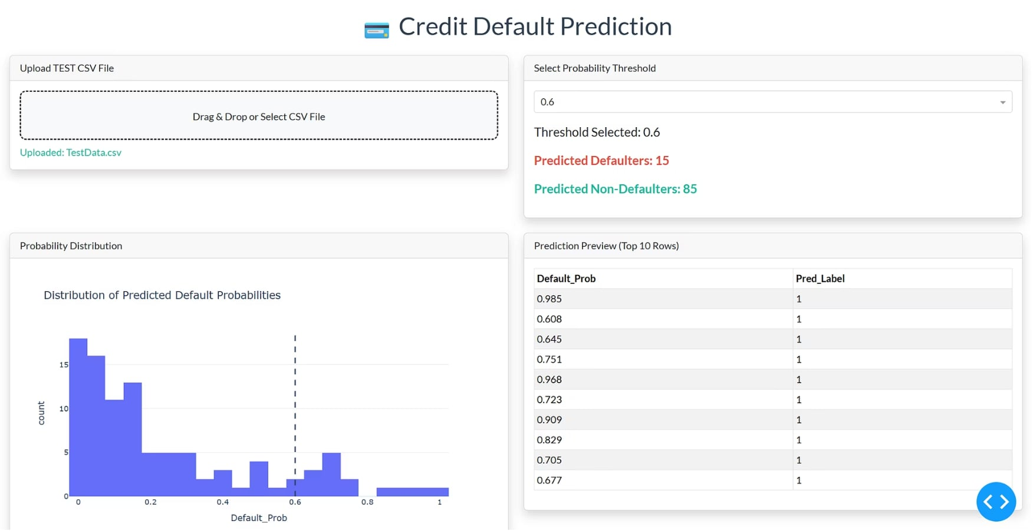
The Dash App in Action
The Credit Default Prediction dashboard shows four live panels: a file upload zone, a threshold selector with real-time defaulter counts, a probability distribution histogram, and a top-10 prediction preview table.
01
02
Uploaded Data Preview
Predicted Default Probability
Confirms the file was received and parsed correctly.
Each customer record receives a probability score from the model.
03
04
Threshold-Based Classification
Real-Time Counts
Users adjust the threshold to tune sensitivity interactively.
Defaulter and non-defaulter totals update instantly on every change.

Slide 17

Advantages of Dash for ML Demos
Dash removes nearly every barrier that traditionally separates ML engineers from shipping functional, interactive user interfaces.
Simple Python-Only Development
No Frontend Skills Required
Build complete web applications without learning HTML, CSS, or JavaScript. If you know Python, you can build a full-featured UI.
Data scientists can independently design and deploy dashboards without depending on a frontend engineer or UX designer.
Interactive and Visual
Great for Teaching & Prototypes
Plotly-powered charts provide an engaging, real-time user experience that makes model outputs easy to understand and explore.
Ideal for classroom demos, academic projects, internal tools, and rapid prototyping before a full production build.

Slide 18

Dash + FastAPI in Real Systems
The industry-standard pattern for scalable, production-ready ML applications combines both frameworks — Dash for the frontend experience and FastAPI for the backend prediction service.
Dash frontend dashboard
FastAPI prediction service
Displays results and visualizations
Handles model inference requests
Production Architecture
JSON responses
Secure API communication
Structured payload for frontend
HTTPS with auth and validation
Scalable
Secure
Production Ready
Handle a growing user base by scaling the FastAPI service independently of the Dash frontend.
Implement proper authentication and authorization at the API layer, decoupled from the UI.
Enterprise-grade deployment with clear separation of concerns between UI and model serving.
This architecture is the natural next step beyond demos and prototypes — the same patterns used by leading ML teams in production.

Slide 19




Key Workflow Components
Our demo project illustrates the complete ML lifecycle — from model training at startup all the way through to a business decision — in a single, cohesive application.
1. Train
2. Upload
Model trained on historical data at server startup. Ready to serve all users instantly.
Business user uploads a test CSV file containing new customer records through the web UI.
3. Predict
4. Decide
Callback fires automatically, running the model and generating default probabilities for each row.
User applies a business threshold to classify customers and act on the results with confidence.

Slide 20
Key Takeaways
Dash empowers ML engineers and data scientists to ship real, interactive applications — no frontend experience required.
1
2
Dash for ML Web Apps
Complete ML Workflow
Dash enables Python-only development of fully interactive web applications, removing the frontend bottleneck for data science teams entirely.
Our project demonstrates the full pipeline: Train → Upload → Predict → Decide. Every step is visible, interactive, and accessible to non-technical users.
3
4
Right Tool for the Job
Bridging the Gap
Use Dash for interactive dashboards and visual demos. Use FastAPI for backend prediction services in production. Use them together for scalable, enterprise-grade systems.
The most important outcome: ML stops living only in notebooks and starts delivering real value to business users through intuitive, self-service web interfaces.

